Slide 1
TEAM
AVENGERS
PPT ON MASK DETECTION

Slide 2


Slide 3


Slide 4
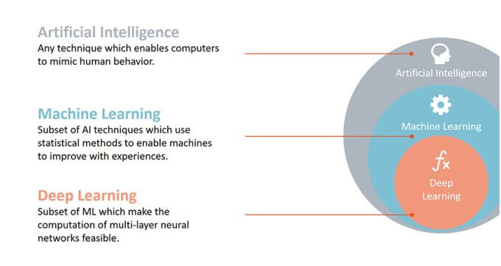

Slide 5
Let’s learn about neural network

Slide 6
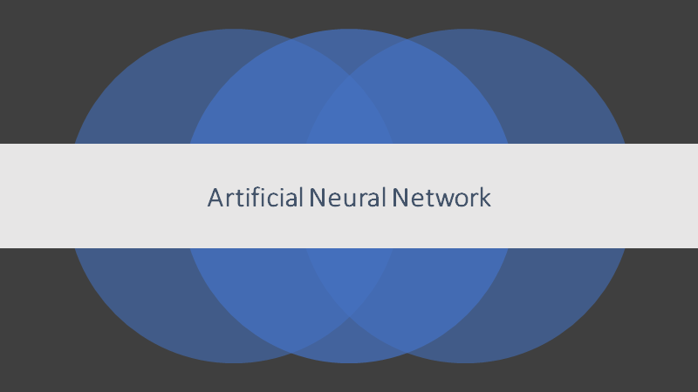

Slide 7
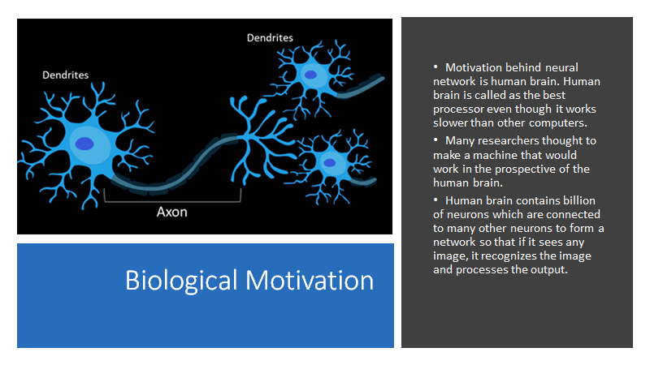

Slide 8
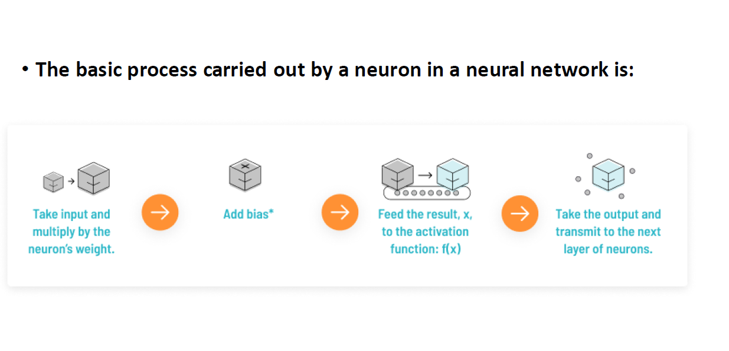

Slide 9
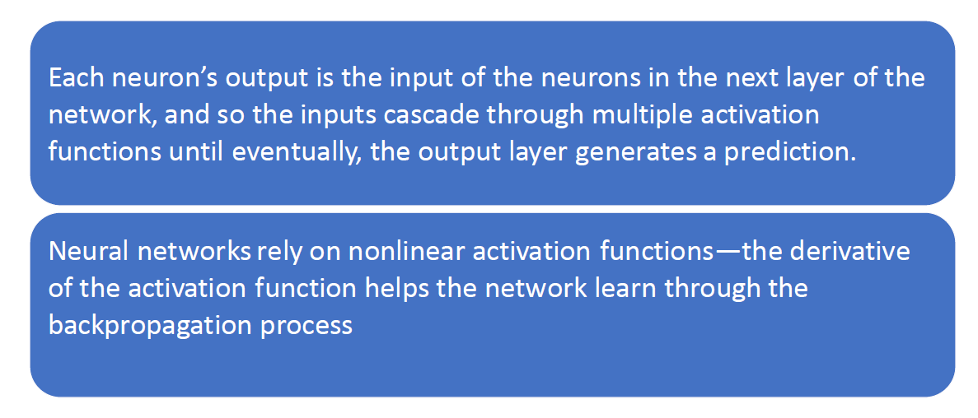

Slide 10


